Slide 1

Google Analytics Capstone Case Study Presented by: Smitha Nair
ANNUAL & CASUAL BIKE SHARE USAGE

Slide 2
AGENDA
1.0 PROJECT SUMMARY
2.0 OBJECTIVE
3.0 DATA & TOOL USED FOR ANALYSIS
4.0 FINDINGS
5.0 RECOMMENDATIONS
6.0 LIMITATIONS

Slide 3
Summary
Cyclistic is a bike-share program launched in 2016 in Chicago, which has expanded to a fleet of 5,824 bicycles across 692 geotracked stations. The program allows users to unlock bikes at one station and return them to any other station at their convenience. While Cyclistic's marketing strategy has focused on general awareness and attracting a broad consumer base, financial analyses indicate that annual members are significantly more profitable than casual riders.

Slide 4

Objective
The primary business task is to analyze the Cyclistic historical data and understand how the casual and annual members use the Cyclistic bike differently.
The case study analysis aims to provide insights into the behavior of two distinct customer segments ,which will assist the marketing team in developing strategies to convert casual riders into annual.

Slide 5
Tools and Data Used For Analysis
Data Source: Cyclistic (Divvy-Lyft) historical trip data downloaded directly from the company’s website.
Period covered: 1-Jan-2021– 31-Dec-2022
Each trip is anonymized and includes:
Ride ID
Rideable type
Start and End date/time
Start and End station name
Member type (Annual-Casual)
Latitude & Longitude
Tools
Data Anomalies were cleaned as far as possible using Excel.
Tableau is used for data analysis and visualization.

Slide 6
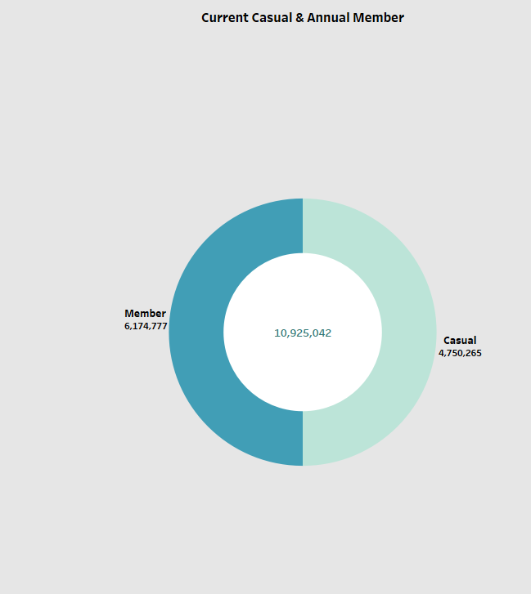
Main Insight: Annual members significantly outpace casual riders in the number of trips taken

Slide 7
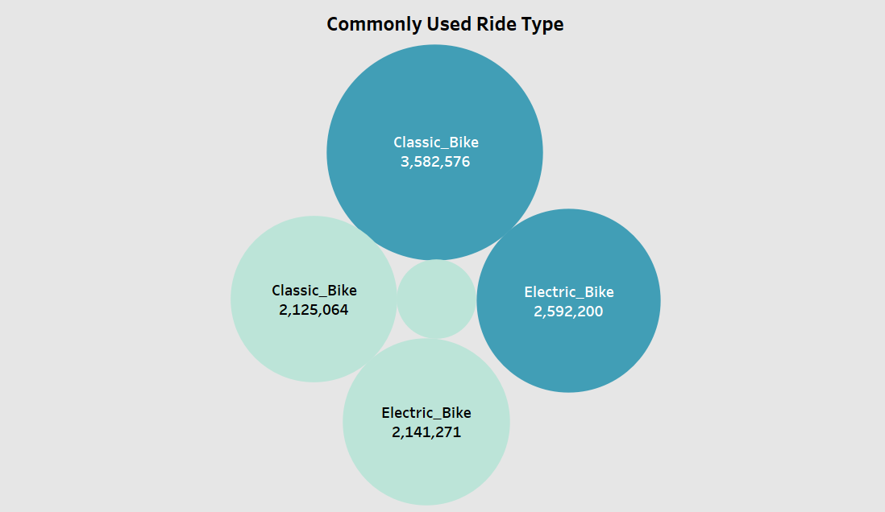
Main Insight: Casual members prefer both classic & electric bike whereas the annual members mostly prefer riding classic bike

Slide 8
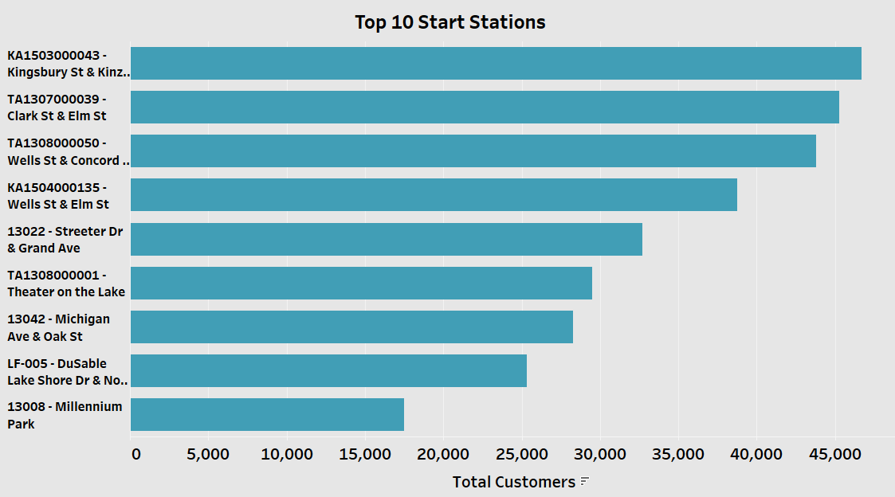
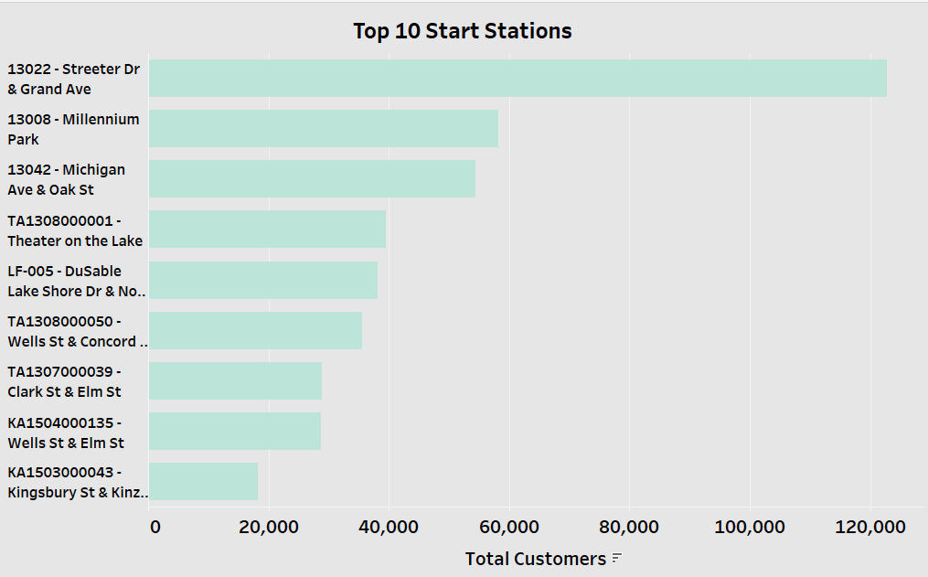
Casual Members
Top 10 Frequently used Start Stations
Annual Members

Slide 9
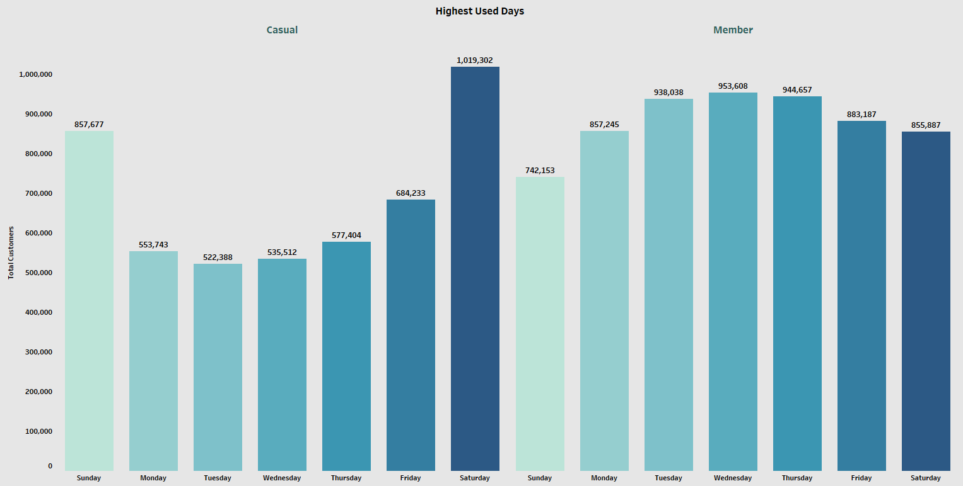
Main Insight:
Casual riders mostly use bikes on weekends i.e Saturdays & Sundays.
Annual members use bikes predominantly on weekdays i.e (Monday - Friday).

Slide 10
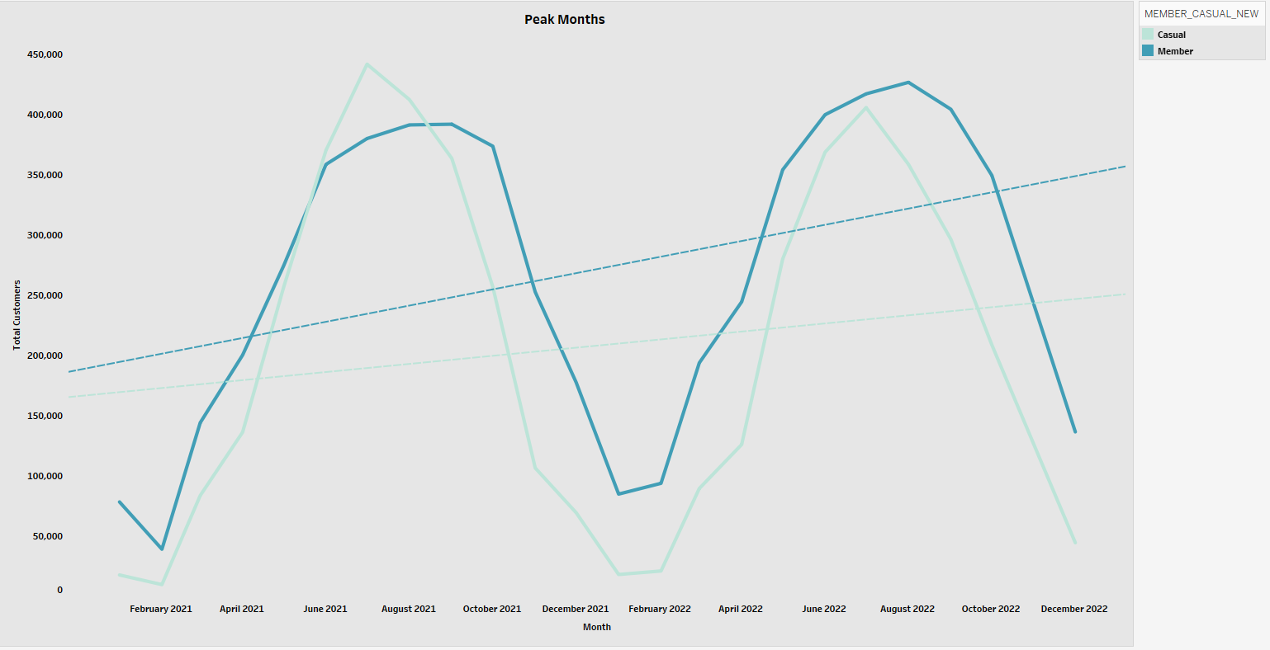
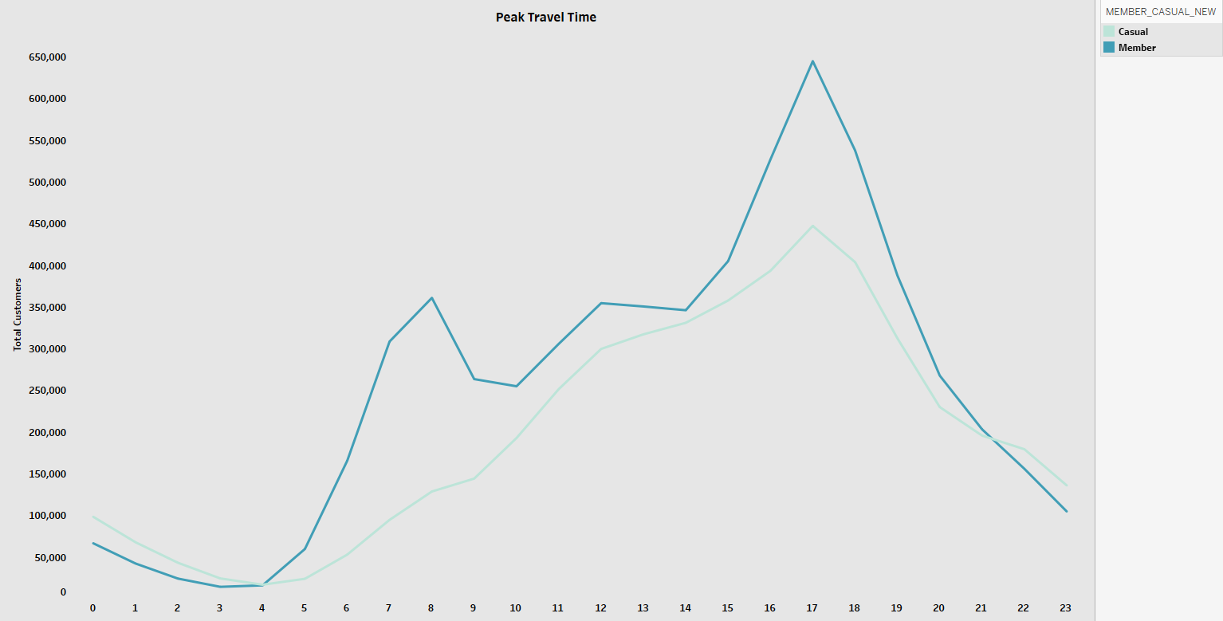
Main Insight
There is sharp rise of riders both casual and annual during summer from May-August
There is an acute decline of bike usage by both segments during winters from September-February .
Peak travel time for casual riders is from 4-6 PM

Slide 11
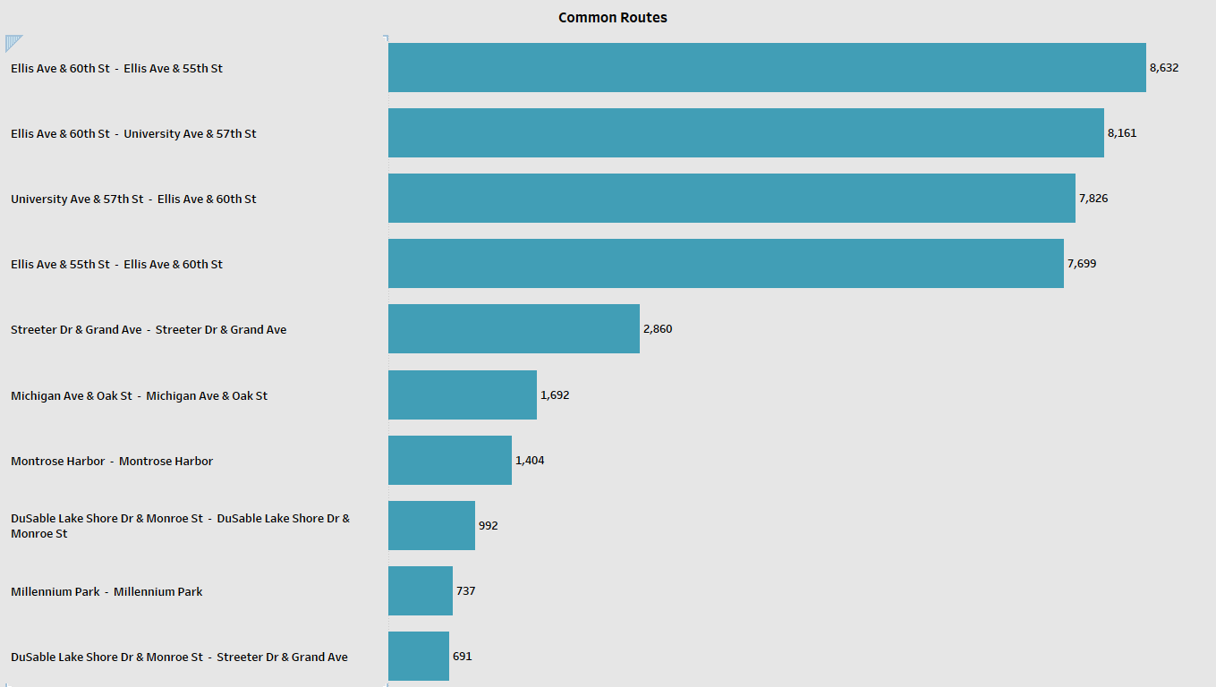
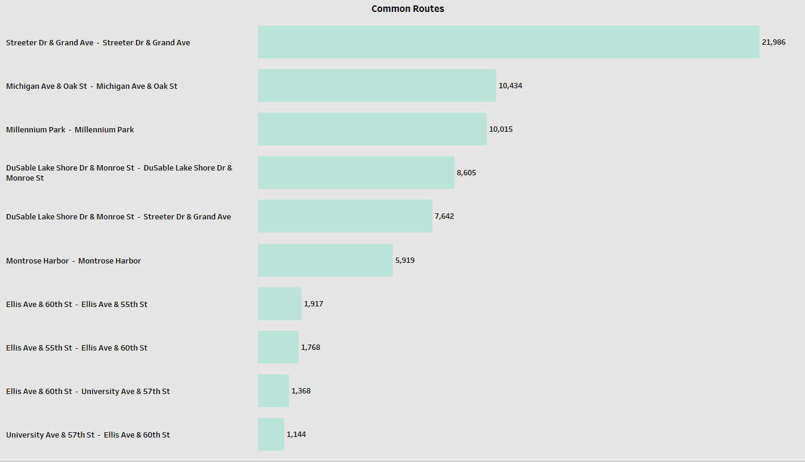
Casual Members
Frequently travelled stations
Annual Members

Slide 12
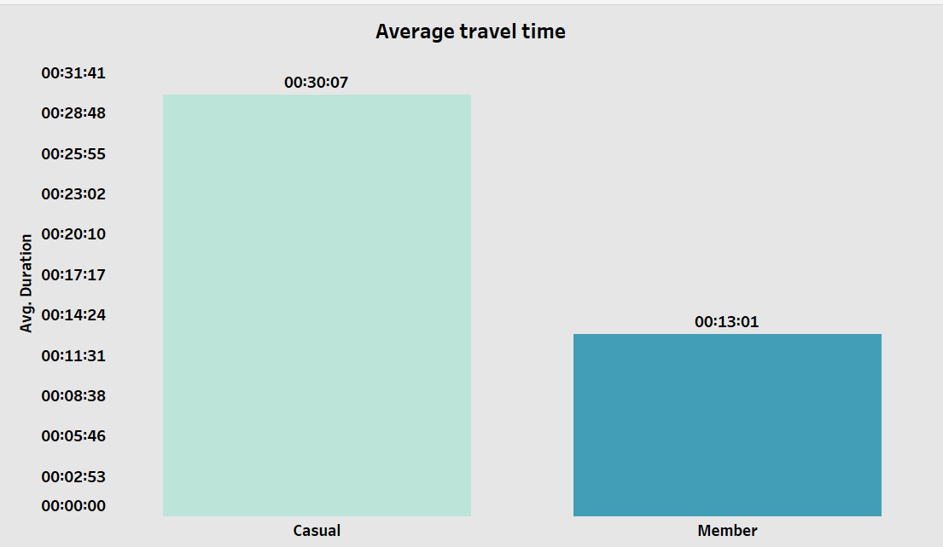
Main Insight:
Casual riders have longer average ride time

Slide 13
Recommendations
To attract more casual riders, marketing teams can offer discounts on electric bikes and classic bikes in exchange for an annual membership.
Casual riders often frequent locations such as Streeter Dr & Grand Ave, Michigan Ave & Oak St, Millennium Park, DuSable Lake Shore Drive, and Montrose Harbor. The marketing team can strategically engage with these riders during peak travel times, particularly between 4 PM and 6 PM, to promote annual memberships that include discounts. This targeted approach allows for direct interaction with potential customers when they are most likely to consider e-bike options, making it an effective strategy for increasing membership sign-ups.
As summer approaches the number of riders both casual and annual increases from June-August. Marketing team can create attractive summer promotions that offer discounts on annual memberships specifically for casual riders.
To effectively convert casual riders into annual members during weekends, when their riding activity peaks, the marketing team can offer weekend-only membership with reduced price.
Since casual riders engage in longer rides the marketing team can emphasize how annual membership can benefit them with unlimited access for longer outing.

Slide 14
Limitations
The absence of demographic data including factors such as age, income level, gender limits understanding of customers preferences, making it challenging to draw accurate conclusions.

